Slide 1
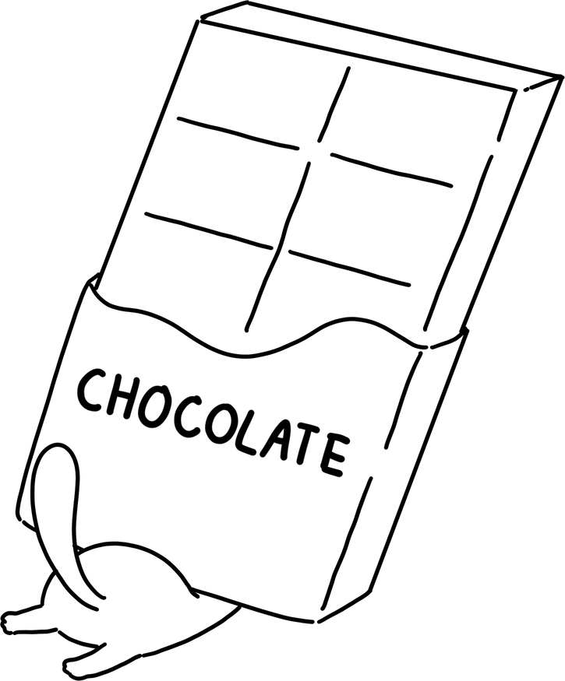
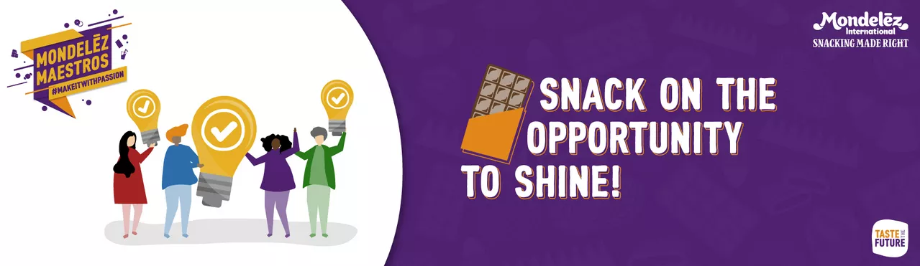
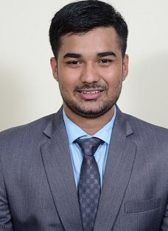


Team - All Stars
Shashank
Navandhar
Rutu
Barve
Sundhara
Pandiyan

Slide 2
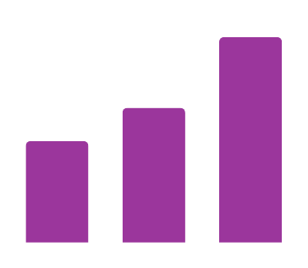

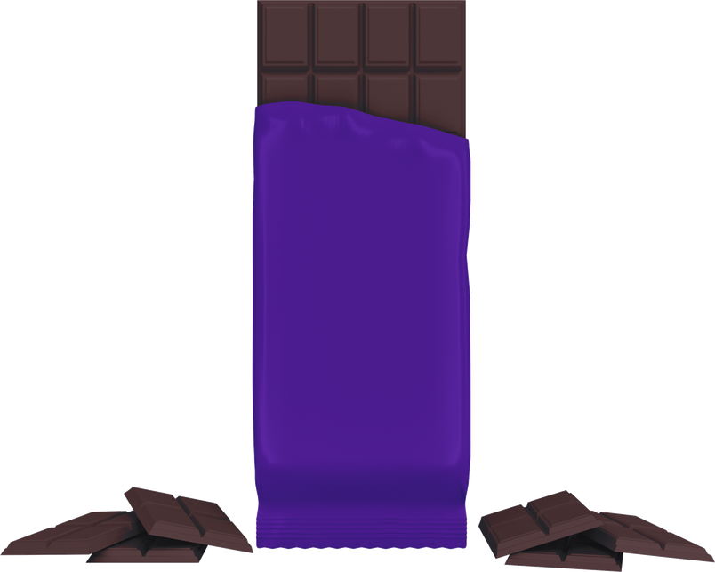
1
Understanding the Market
2
3
4
5
1
6
7
Market Landscape
Understanding The Problem Statement
Dark Chocolate Market Growth in India
The Ask : First Choice of Dark
Previous Round Recap
(In ₹)
237B
Understanding key triggers & barriers to consumption of dark chocolate.
The proposed strategy for Bournville was to promote it as a stress-relieving dark chocolate.
Chocolate
According to Euromonitor, chocolate market (155.7 B) has expected CAGR of 8.8% (2022-27) increased from 5.7% (2017-22)
Dark Chocolate
What can Bournville do to build long term competitive advantage across 4Ps?
Emphasize on the psychoactive ingredients & flavonoids present in dark chocolate.
155.7B
118B
Resources that organization needs to invest for an end-to-end implementation.
This involves introducing 15gm bite priced at 10Rs.
41 B
Utilize existing distribution channels & implement a marketing campaign that includes advertising, influencers & in-store engagement.
12 B
15.5B
Dark Chocolate segment growing at 2x that of chocolate segment as outlined in the case.
Generate 10x Revenue in the timelime of 3 years.
2017
2022
2027
Dark is 10% of Indian Chocolate Market - Economic Times 2023
Purchase Drivers in Indian Chocolate Market
Understanding The Options
Health Conscious
Statista reported 61% consumers willing to switch to healthier snacking habits.
Previous Round Recap
Expand Bournville Brand
Fresh Campaigns
Can result
Customer Confusion
Existing SKU
Evolving
Palates
Palates moving beyond familiar traditional desserts, embracing the complex flavors.
Focus
Existing Customers
Consumption Triggers
Avoid
Portion
Control
One-sixth Indian consumers prefer smaller chocolate portions according to Mintel report - Serious Chocolate Business.
Bournville First Choice of Dark
New SKU
Solution!
Customer Acquisition
Barriers of Purchase
Willing to Explore
Dark Chocolate no longer seen as foreign, but a taste to be explored.
Best way to promote
Double-Edged Sword
Grow Dark Segment
Low Sugar & Healthy
Cannibalize Dairy milk
Chocolate Sales

Slide 3
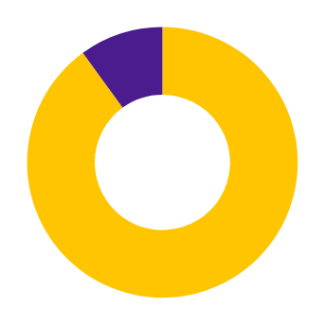

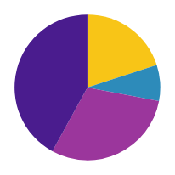
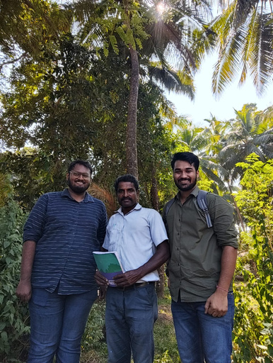
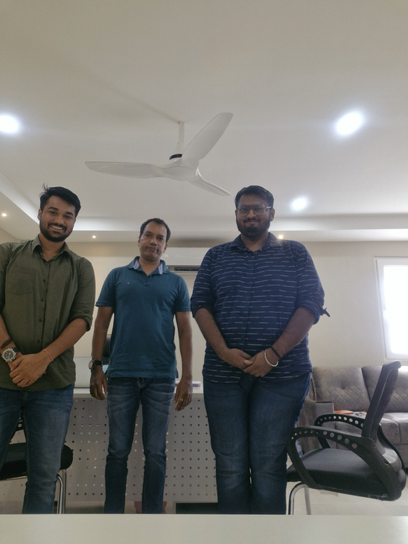
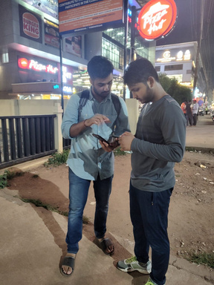
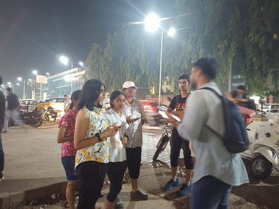
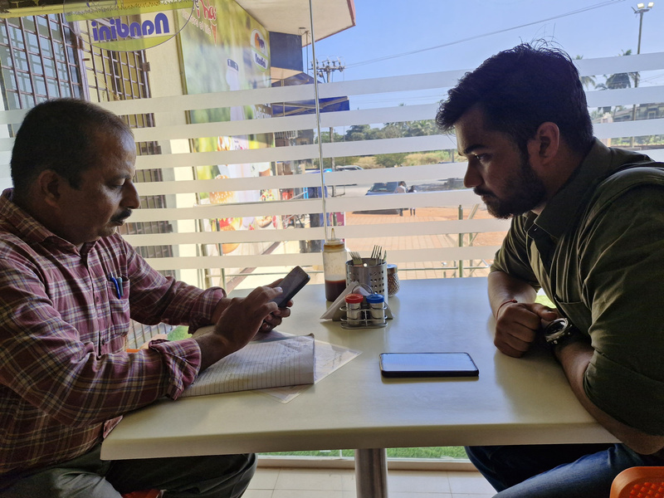
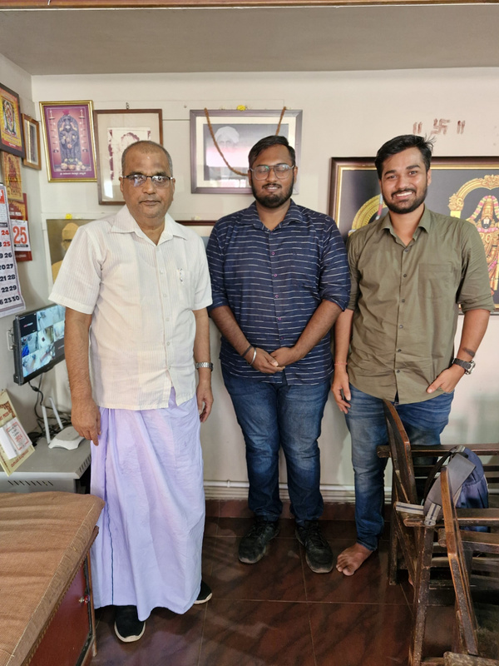
1
2
Understanding the People
3
4
5
1
6
7
Consumer Survey
Focus Group Discussion
Surveying Customers:
Need-gap Analysis:
Key Insights:
Opinions on SKUs:
Focus Group Discussion:
Customer Responses
Survey Details - 152 Respondents, 14 States
Chocolate bars pose challenges in terms of portability, storage, and sharing.
Stressful times like exams, deadlines, & commute are consumption triggers of dark chcolate.
Smaller portions would help reduce mess while storing.
90% respondents reported to know of the Bournville brand.
Smaller packs help not only for sharing but for individual indulgence.
Liked the gifting idea but suggested to start with price range of 250 to 300 rupees.
Aware of Bournville?
Yes
Share chocolate with family or friends.
No
This validated the high brand awareness of Bournville.
Bournville Dark Chocolate lack availability & shelf display at multiple retailers.
Cannot eat the 100 rupees bar in one sitting.
Bought Bournville in last 6 Months?
10%
Compact and convenient, small bites are perfect for work, school, and travel.
52%
52% respondents had not eaten bournville in the last 6 months.
Sugar-free dark chocolate is desired by health-conscious consumers.
Consumption frequency is 1 - 4 times in a month.
48%
90%
64% respondents said they don’t eat entire bar of dark chocolate in one sitting.
Meeting The Stakeholders
Pricing Details:
Meeting Sales Executives:
Meeting Distributor & Wholesaler:
Sku Options
Key Insights:
Cadbury SE
Distributor - Cadbury
Key Insights:
Smaller sized options, especially with lower prices, resonated most with respondents, with the ₹20 (15g) variant hitting the sweet spot.
20%
8gm
1.Purchase factors - Taste, iiiiPrice, Quality, Awareness.
1.Consumers have started to iiavoid sweet chocolate.
42%
8%
15gm
Raju Poojary
30gm
2.No Seasonality.
R.R Distributors
2. Unlike Amul, Mondelez iiiiiprovides for reverse supply oiichain.
30%
80gm
3.Diabetics among frequent ssiibuyers.
Smaller Bites - individually wrapped, make them more portable & easier to share.
4.Avg retailer margin 10%.
Nestle SE
Wholesaler - Amul
3. Avg margin for distributor iIIII4 - 5%.
5.Far less BTL material as
xiiicompared to milk xiiichocolates.
Prashant Hegde
Savor each bite more & appreciate the flavor and texture better.
Modern Traders
4. Doctors frequently ioirecommend eating dark.
*Snapshots of Survey Collection

Slide 4
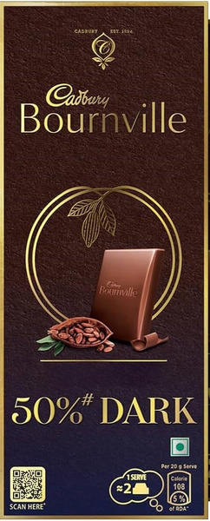




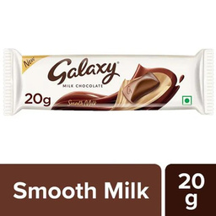
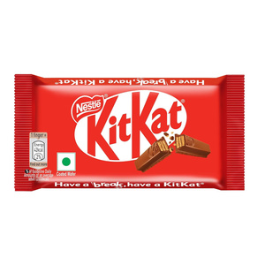
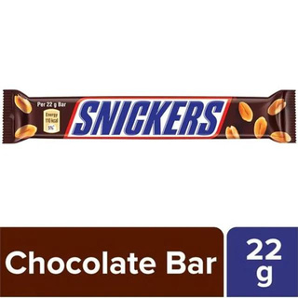
1
2
3
Building Idea - Product - Price
4
5
6
7
Mindful Moments
Target Groups
Dark Bite:
Working Professionals & Students -
15g Dark Bite
Connoisseurs:
Healthy Indulgers:
Open up for calm, Bournville's 15g mood-boosting bites for self-indulgence.
Beautifully Packaged - Visually Appealing.
Detailed nutrition information on packaging.
Pouch Packs:
12gm Bite
10 delectable bites, focused on portion control and sharing.
Smaller SKU to carry in
pocket, handbags & purse.
Consuming to regulate mood & stress.
Gift Boxes:
Ideal for sharing with friends & family.
Fitness Freaks:
Gifting curated delights, highlighting the variety of Dark.
Thoughtful Gifters:
Balance active lifestyle.
Mini rewards for hitting milestones.
Celebrate achievements with a reward that's guilt-free and delightful.
Enjoy a small treat without exceeding sugar intake.
Price Points
Corporate gifting options.
Dark Bite:
₹20
Bournville - Value Journey
A rich escape for just , making luxury accessible to all.
₹200
Premium Packaging -
Individual Indulgence -
Curosity -
Elegance -
PouchPacks:
10x15g mindful bites for
shareable indulgence meets value-conscious craving.
Sophisticated visual appeal
Satisfying chocolate experience
Exploring complex flavors of dark chocolate
Refined taste & lifestyle
High-end Brands like Galaxy have introduced varients in ₹10-20 segment.
Portion Control -
Sharing -
Mood Regulation -
Self-control-
Bournville Gift Boxes for every occasion, with price starting from
Promotes mindful consumption
Portable & easier to share
Emphasising well-being & relaxation
Mindful choices
Gift Boxes:
Bournville's ₹ 20 bites can unlock the dark chocolate for a premium upgrade.
₹250.
Attributes
Functional
Psycho-Social
Personal Value

Slide 5













1
2
3
4
Irresistible Promotions
5
6
7
Stress Hai - Share Kar
Through The Line
Campaign Brief:
Will Dark Chocolate Help?
Sharing Helps reduce stress:
Partnerships:
"Stress Hai Share Kar" campaign links stress & chocolate consumption, prompting individuals to share their stress while enjoying Bournville Bites.
University College London study led by Dr. Sarah Jackson surveyed 13,626 adults in the United States.
Sharing your stress helps in:
Releasing pent-up feelings.
Realizing many share similar feelings.
Gaining a different perspectives.
Partner with travel companies or airlines to offer the dark bites as welcome treats or in-flight snacks.
Individuals reported eating dark chocolate in two 24-hour periods had 70% lower odds of reporting relevant depressive symptoms compared to those who had not eaten dark chocolate at all.
Partner with high-end hotels by featuring Bournville as an in-room snack.
Position Bournville as a preferred solution for moments of tension & experience.
Digital Marketing:
Psychologist, Cohen, S. in his research paper - “ Social Relationships & Health” reports social support has direct effects on health through enhanced mental health, by reducing the impact of stress.
Targeted Ads: Utilize platforms like Facebook & Instagram to target specific demographics like health-conscious & busy professionals.
Cocoa can act as natural stimulant, potentially reducing feelings of fatigue & sluggishness associated with stress.
Above The Line
Below The Line
Event Sponsorship:
Partner with podcast hosts to authentically integrate Bournville into the show's theme or discussions.
TV: 836 Million TV owning Individuals The average MROI for TV advertising in India is around 10%.
General Trade Strategy:
Product placement plays an important role in consumer purchase process. By providing Incentives and promotions to the outlets we ensure competitive space in the counter.
Partner with yoga studios to offer branded yoga sessions featuring Bournville chocolate as a post-session treat.
OTT: The MROI for advertising on OTT platforms in India is estimated to be around 20-30%.
Sponsor Display ads: Display ads, Native ads, Search ads, Remarketing ads are some mediums available on emcommerce platforms like BlinkIt & Jiomart.
Corporate Wellness Programs:
Print: The average MROI for print media advertising in India in 2022 was 11%.
Bournville can work with HR departments & Corporate Wellness Providers to conduct stress management workshops.
Billboards: According to a study by Hubspot, the average MROI for billboard advertising in India is about 40%.
Modern Trade Strategy:
12gm Bite
Capture attention with striking posters, tempt taste buds with themed end caps, spark impulse buys at counters.
The approach should be informative, engaging, and non-pushy. Focusing on education, mindfulness of corporate wellbeing.
#StressHaiShareKar

Slide 6
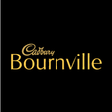

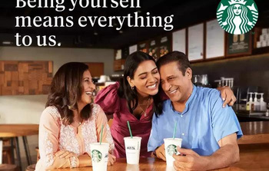
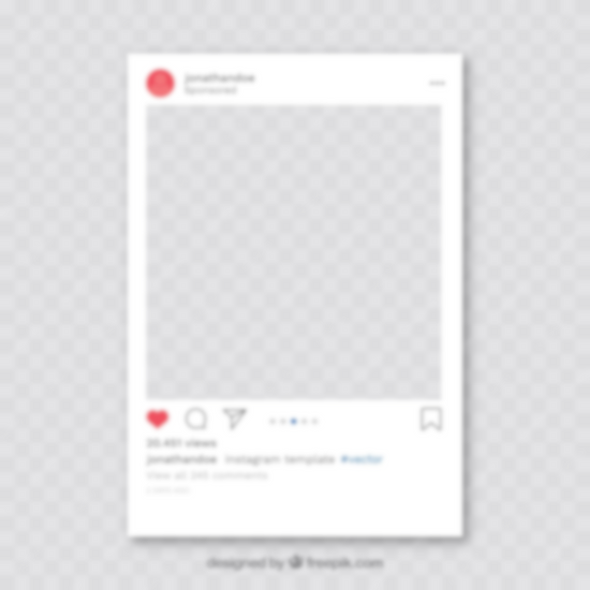
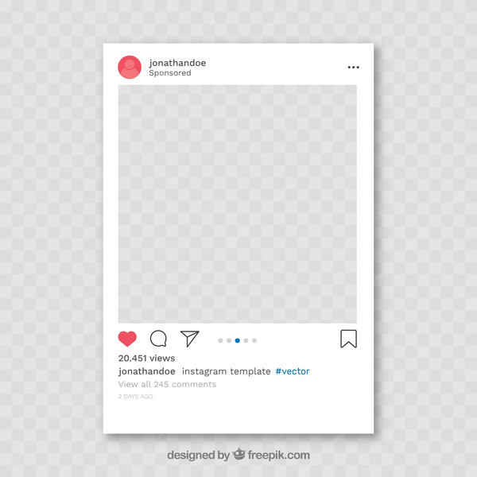





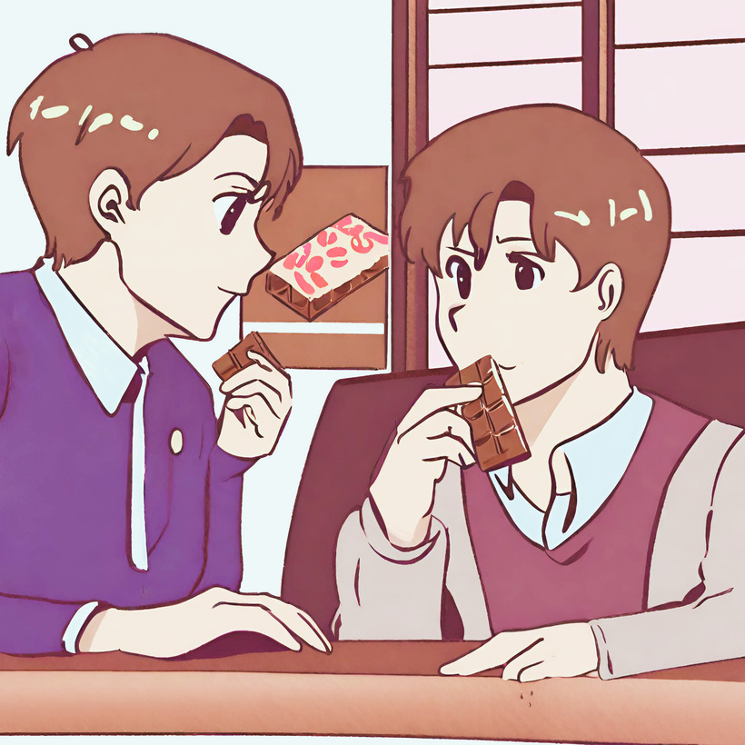

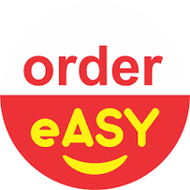
1
2
3
4
5
Irresistible Promotions
6
7
Bournville & Starbucks
Social Media Campaign
How to collab?
Starbucks & Stress:
Why QSRs like Starbucks?
Social media campaigns provide targeted advertising, measuring results of the campaign.
Starbucks beverage featuring Bournville dark chocolate favour or drizzle.
Starbucks has launched an app to help its employees to deal with anxiety & stress.
The average ROI for social media marketing in India is 23%, according to a survey by Meltwater.
Premium segment of their respective market.
#itstartswithyourname campaign - sparks social conversation & fosters empathy.
Our campaign wants to spark such conversation around stress
Aspirational Marketing:
Leverage Starbucks channels to reach a wider audience and engage in co-branded campaigns.
Both brands focus on urban, affluent consumers who crave indulgent escapes.
Collaborate with successful individuals or brands to associate Bournville with achievement & refinement.
Promote Bournville as a way to practice self-care while catering desire for pleasure & self-improvement.
Gift boxes combining Starbucks coffee & Bournville chocolates.
Focused on creating positive customer experiences.
Short, relatable videos of people sharing their triggers & coping mechanisms. The videos end with them enjoying
iiiiiiiiBournville & feeling a sense of relief.
Advertisement Template
Implementable Ideas:
Run social media campaign encouraging users to share their worries & anxiety.
Partner with stress management experts to offer virtual workshops on managing stress.
#StressHaiShareKar
#StressHaiShareKar
Stress Hai Share Kar
Trade Promotion
Mondelez B2B application (EasyOrder):
SKU-Driven Incentives:
Offer special schemes for Dark bite SKUs, driving targeted sales and promotions.
Implement nudges for inventory stocking.
Special margins to be introduced for motivating retailers, Area Sales Managers and distributors.

Slide 7

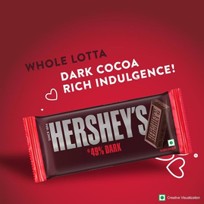


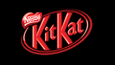




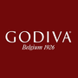
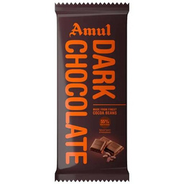
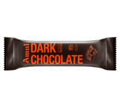
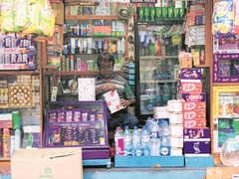
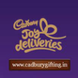

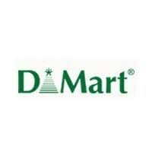


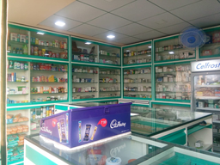
1
2
3
4
5
6
Claiming Dark Chocolate Shelf
7
Procurement
Competitors
Cocoa Life Programme:
Dark Competitors:
The Amul Story:
Indirect Competitors:
India's cocoa production, mainly in Kerala, Karnataka, Andhra Pradesh & Tamil Nadu, 28,000 MT.
Indian Demand -
After 100 rs SKU, Amul introduced a 25rs bar to tap into a much larger segment.
Cookies, candy bars, and ice cream - treats that satisfy a sweet tooth.
50,000 MT
Production -
28,000 MT
Plan B : A smaller SKU (10rs) available in-case 25rs price is perceived as expensive.
Herbal Teas, known for their stress-reducing properties.
Mondelez India, sourced 30% of its cocoa requirement indigenously, as of 2021.
Based on Directorate of Cashewnut & Cocoa Development India.
Premium milk chocolate brands, aiming for sophisticated consumers.
Increase Domestic Cocoa Production:
IIIIIISupport existing cocoa farmers with IIIIIItraining to improve yields & quality.
IIIIIIExpand cocoa cultivation by encouraging IIIIIInew farmers to enter cocoa production.
The maker of Cadbury aims to source 100% of its cocoa requirements through its own network of cocoa farmers by 2025 according to Fortune India Interview.
Introduce 15+ dark flavours to create buzz among consumers.
Healthier snacking options like Dried fruits, nuts, & yogurt, especially for health-conscious consumers.
With influx of new entrants, a powerful brand can become an important competitive advantage.
Cocoa sourced directly from the Karavali region of South Karnataka.
Distribution Strategy
Dark Bites:
PouchPacks:
Gift Boxes:
Modern Trade: 5,000-7,000 supermarkets and hypermarkets like Reliance Fresh, DMart, etc.
Modern Trade: 5,000-7,000 supermarkets and hypermarkets like Reliance Fresh, DMart, etc.
Modern Trade: Same as PouchPacks (5,000-7,000 supermarkets and hypermarkets).
General Trade: 200,000-300,000 kirana stores across India, focusing on high-traffic locations.
General Trade: 200,000-300,000 larger kirana stores with dedicated shelves for packaged snacks and chocolates.
E-commerce: Platforms like Amazon, Flipkart focusing on targeted advertising and festive season promotions.
Medical Stores: 15,000-20,000 pharmacies, particularly those catering to diabetics & health-conscious customers.
Quick Commerce: Featuring on apps like Blinkit & Zepto
Incentives:
Incentives:
Incentives:
1. Offer attractive bulk discounts and seasonal promotional IIIIpackages for modern trade retailers.
1. Offer special counter space displays, shelf IIIIarrangements, & promotional materials for Kirana OIstores and pharmacies.
1. Negotiate shelf space allocations & end-of-aisle displays in IIIImodern trade outlets.
2. Partner with e-commerce platforms for exclusive launches, iiiiiflash sales, and sponsored ads.
2. Offer bundle deals or multi-pack discounts for kirana stores & IIIIpharmacies.
3. Provide dedicated marketing resources and customer xiservice support on the Mondelez gifting site.

Slide 8




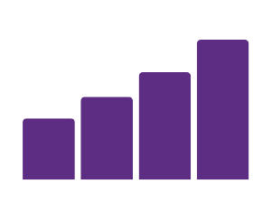


1
2
3
4
5
6
7
Financial Journey
Cost - Impact - Effort
Revenue Analysis
Campaign
Impact
Cost
Note: Mondelez India recorded a revenue of 9296 cr in FY 22, 70% of which account for chocolate segment. Assuming 3% of that accounts for dark chocolate, we estimate 195cr as Bournville revenue in 2022.
Effort
( INR Cr )
Digital Ads
31.4 Cr
Indian Chocolate Market Size 2022
Mondelez India Revenue 2022
15 Sec Ad 200 Cr Views on OTT across 3 years
15512 Cr
9296 Cr
TV Ads
10% accounts for Dark Chocolate
70% accounts for Chocolate
33.7 Cr
1551 Cr
6507 Cr
25 Sec Ad 5 Channels 12 months across 3 years
Estimating 12.5% Market Share
Estimating 3% is Bournville
~194 Cr
~195 Cr
Billboards & Print
7.2 Cr
500 Locations for 6 months across 3 years
Assuming 16% CAGR In 2023 Bournville Revenue -
~226Cr
Social Media Campaign
Plan A : Stress Hai Share Kar
Plan B : Self Indulgence
Social Media Ad post 50Cr views & 50+ Influencers across 3 years
3.5 Cr
Revenue growth % for 3 years
24%
Revenue growth % for 3 years
24%
24%
16%
24%
Partnership Budget
32%
Budget allocated for over the table deals with potential partners (QSR)
10 Cr
298 Cr
369 Cr
458 Cr
262 Cr
325 Cr
403 Cr
226 Cr
226 Cr
Event Sponsorship
10 Cr
Current
Year 1
Year 2
Year 3
Current
Year 1
Year 2
Year 3
Sponsor events /wellness programs to integrate Bournville into discussions
First three years revenue: 1125 Cr
First three years revenue: 990 Cr
Trade Promotions
We estimate a 32% sales boost in the 1st year based on new skus & campaigns.
In case this proposition is not well received our plan B helps us bounce back.
General Trade – 1.5 Cr, Modern Trade – 0.5 Cr, E-com – 0.5 Cr, BTL – 1.5 Cr
4 Cr
Click here for Appendix

Slide 9
Q&A with the Jury
Team - All Stars

